Slide 1
Community detection in VK
Stepanov Yaroslav
Lobachev Nikita
Andreev Mkhail

Slide 2
Plan of the work
Obtaining data
Working with VK API
JSON and CSV organization
Designing graph
Implementation of Karger’s algorithm
Comparing with algorithms in Community and Networkx Python libraries

Slide 3
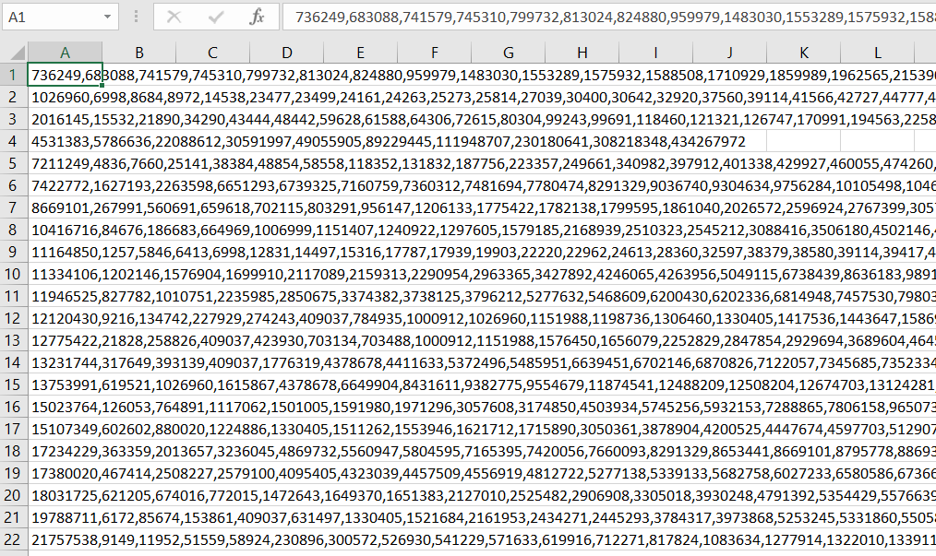
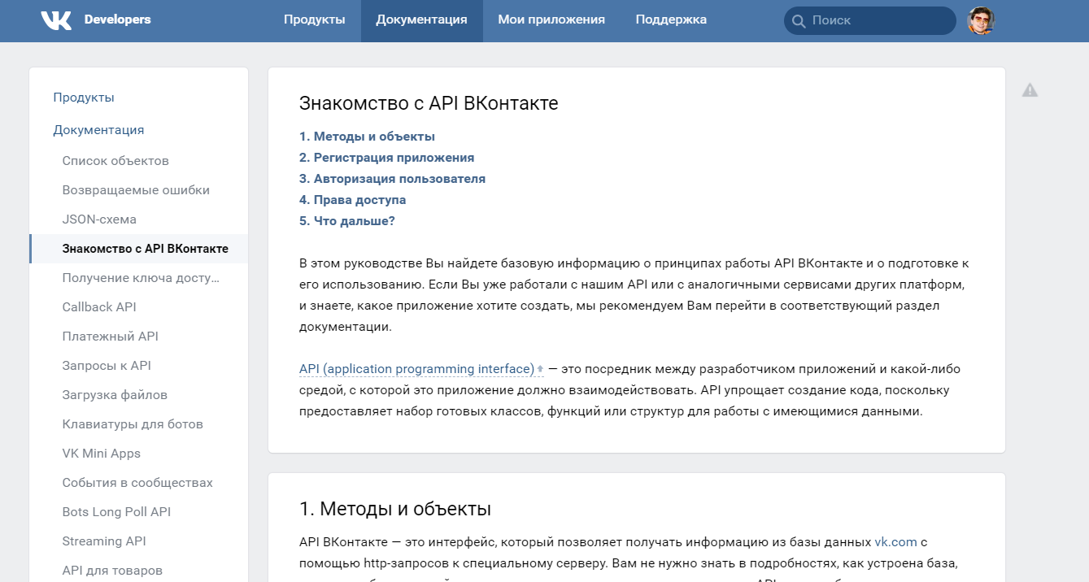
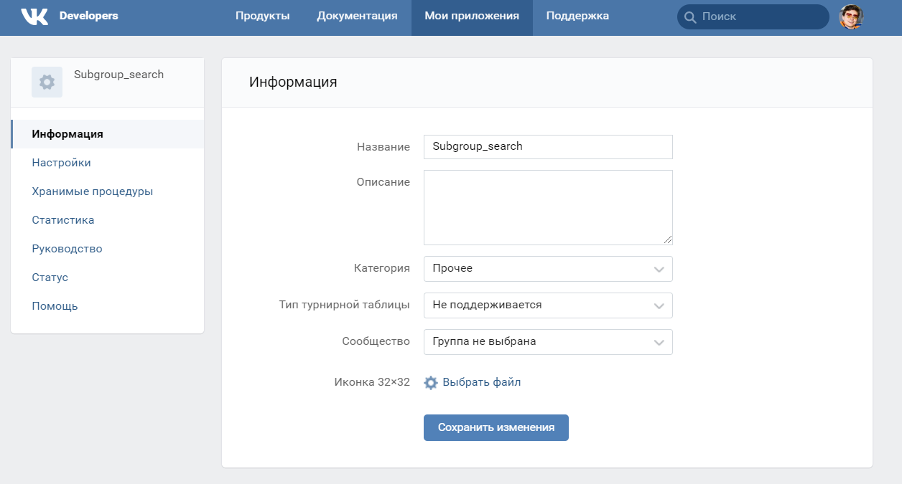
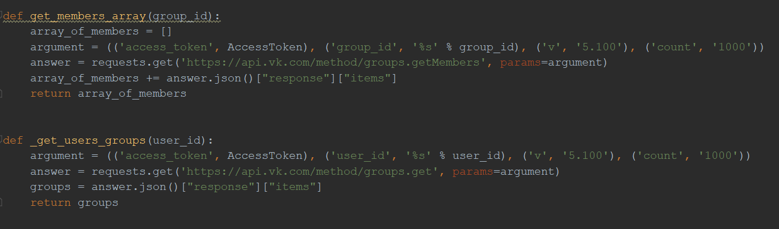
Obtaining data

Slide 4
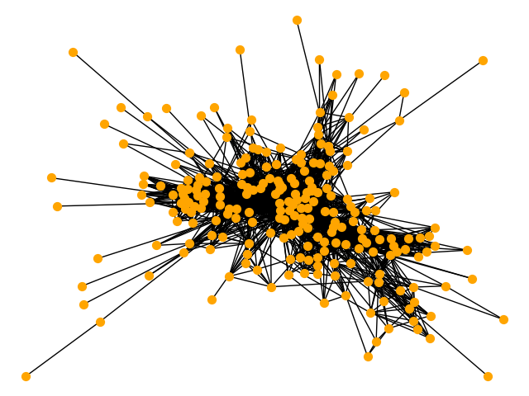
Graph obtained from VK API

Slide 5
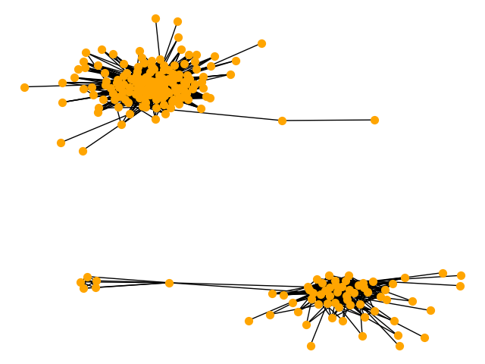
Using Karger’s algorithm we got two subcommunties
Before
After

Slide 6
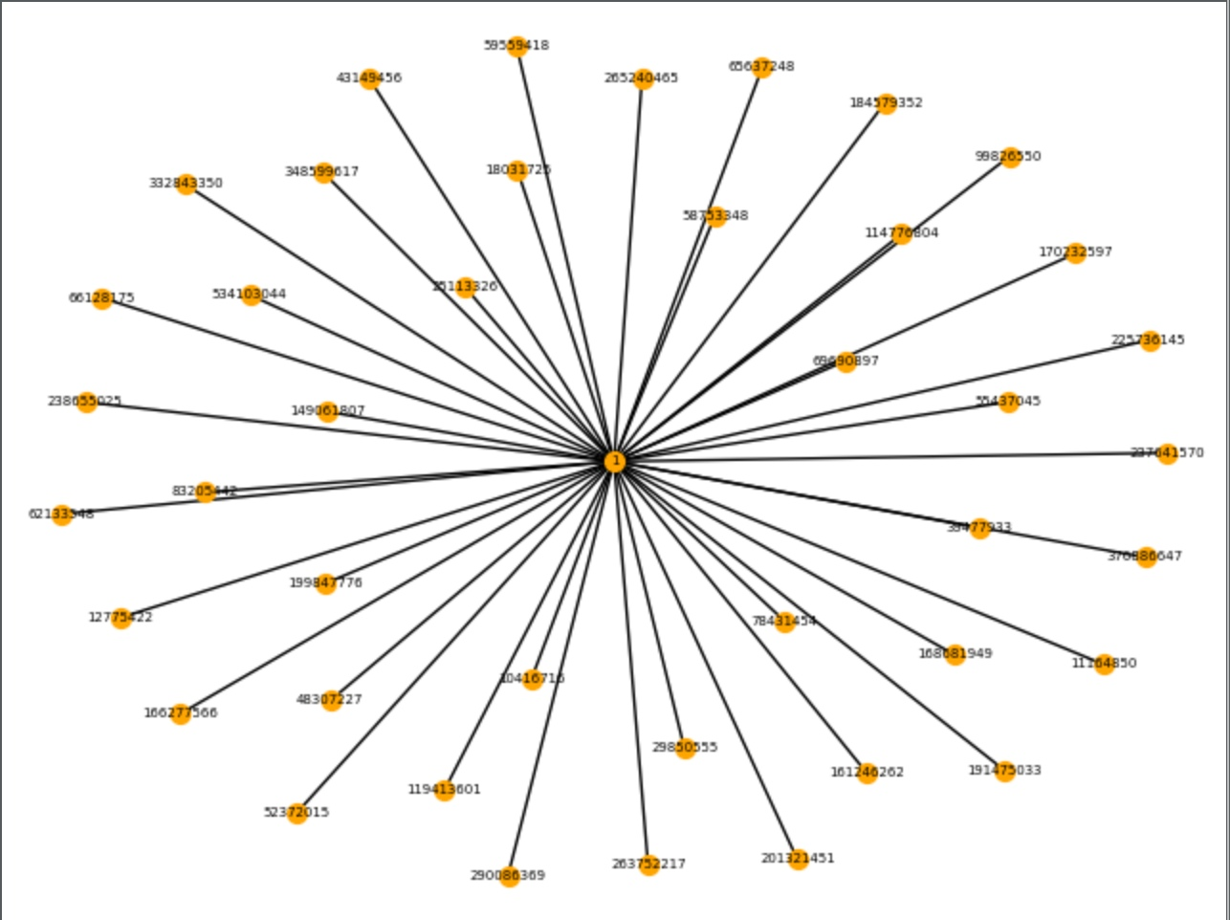
And applying Community library algorithm
(best partition method)
Before
After

Slide 7
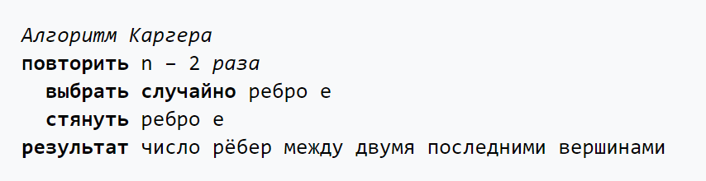
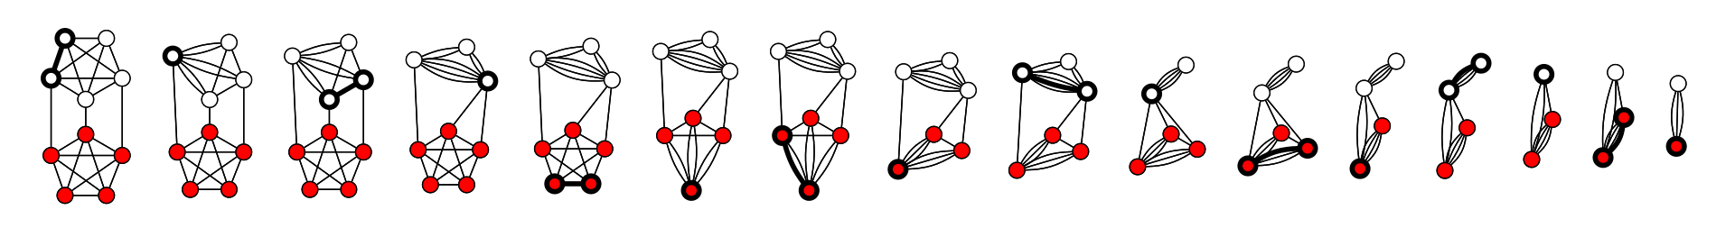
Karger’s algorithm
Pseudocode

Slide 8
An algorithm based on networkx function
For another algorithm we’ve decided to use networkx function “minimum_cut”. In ideal after finding minimum cut by that function, we get a partition, so we can simply remove edges from different parts of this partition and we will get two “subcommunities”. However, in reality we face a problem, because as parametres of the function we should have “source” and “sink”, and after we compute the function, most often we have only one node in one of the partitions. So we have to choose new “source” and “sink” and compute again. And it requires some time. So, for our graph it works approximately 14 seconds.

Slide 9
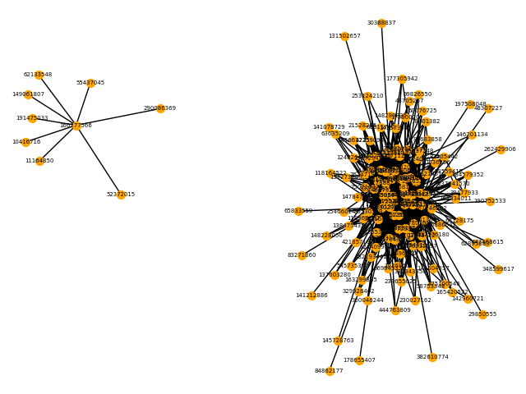
Using “min_cut” function

Slide 10

Are there any dependencies?
In order to find a dependency in “subcommunities” we analyse members of each and construct a new graph in which nodes have an edge only if two people are friends.

Slide 11
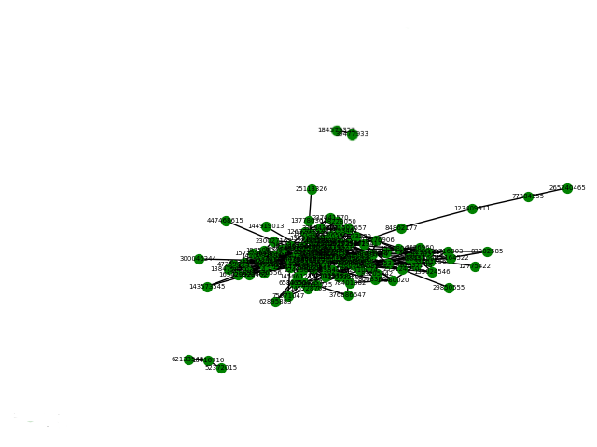
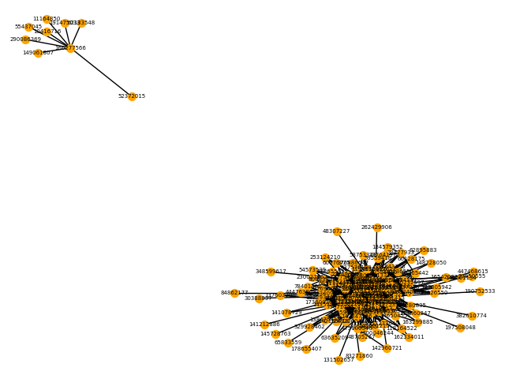
9 members
2 friends
117 friends
3 friends
129 members

